Slide 1
CSE-490 Midterm
By Trevor Alexander

Slide 2
Deliverables
A Midway University themed webpage
Every button to go a midway webpage
YouTube links for every course explaining them to a new student
A text to speech button that would read the summaries of each course

Slide 3
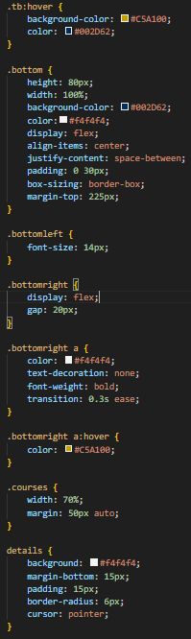
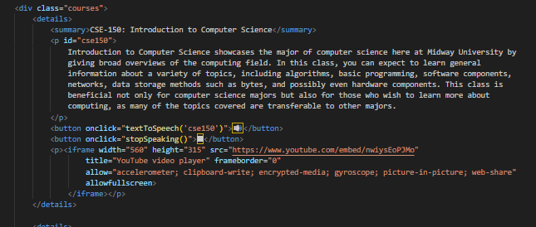
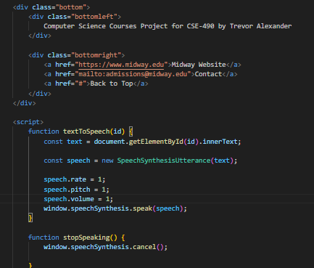
Backend

Slide 4
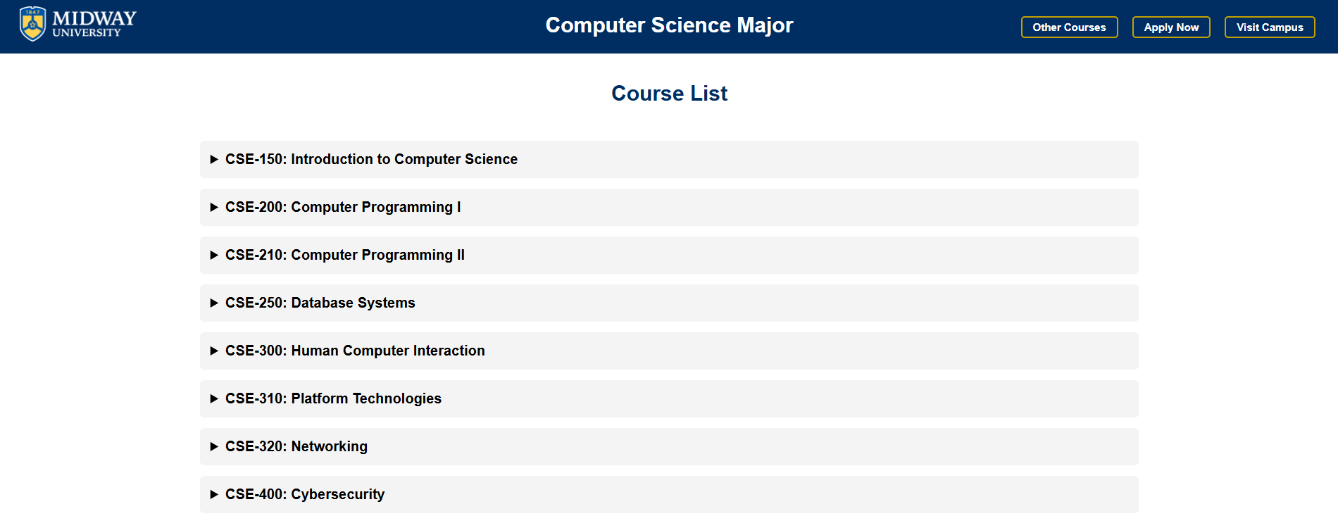
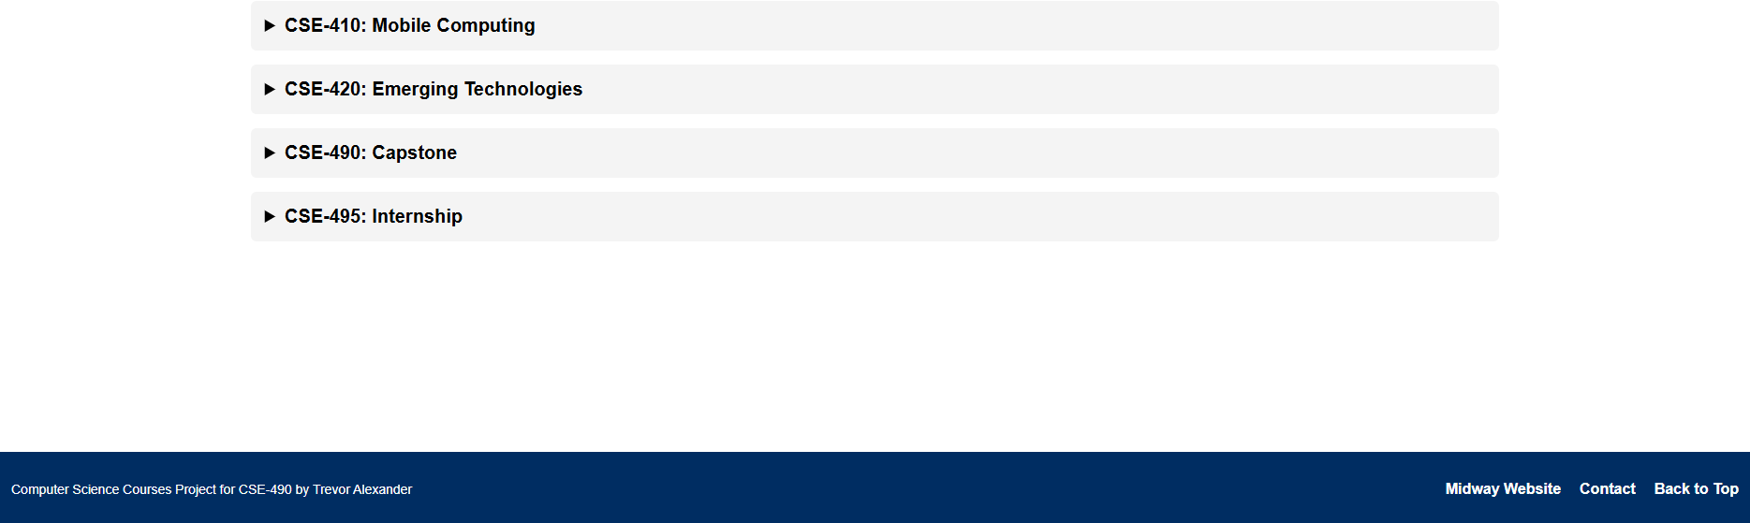
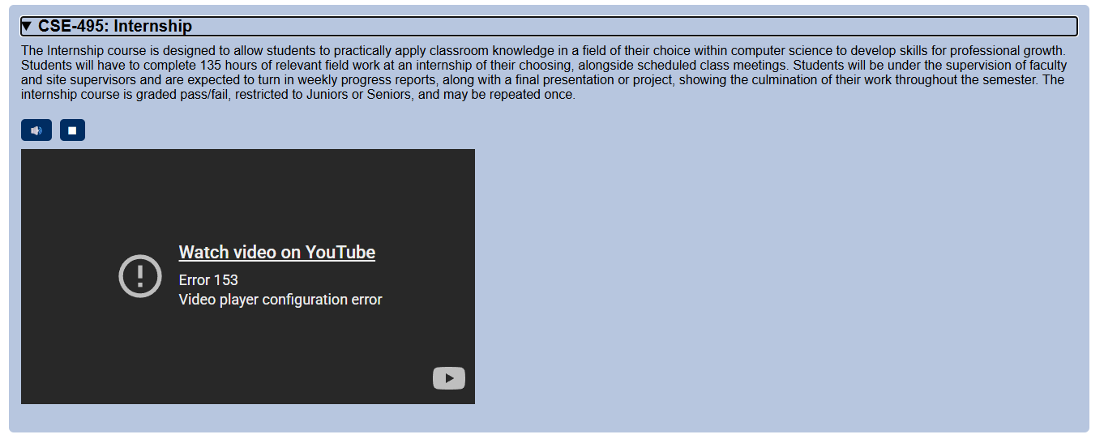
Frontend

Slide 5
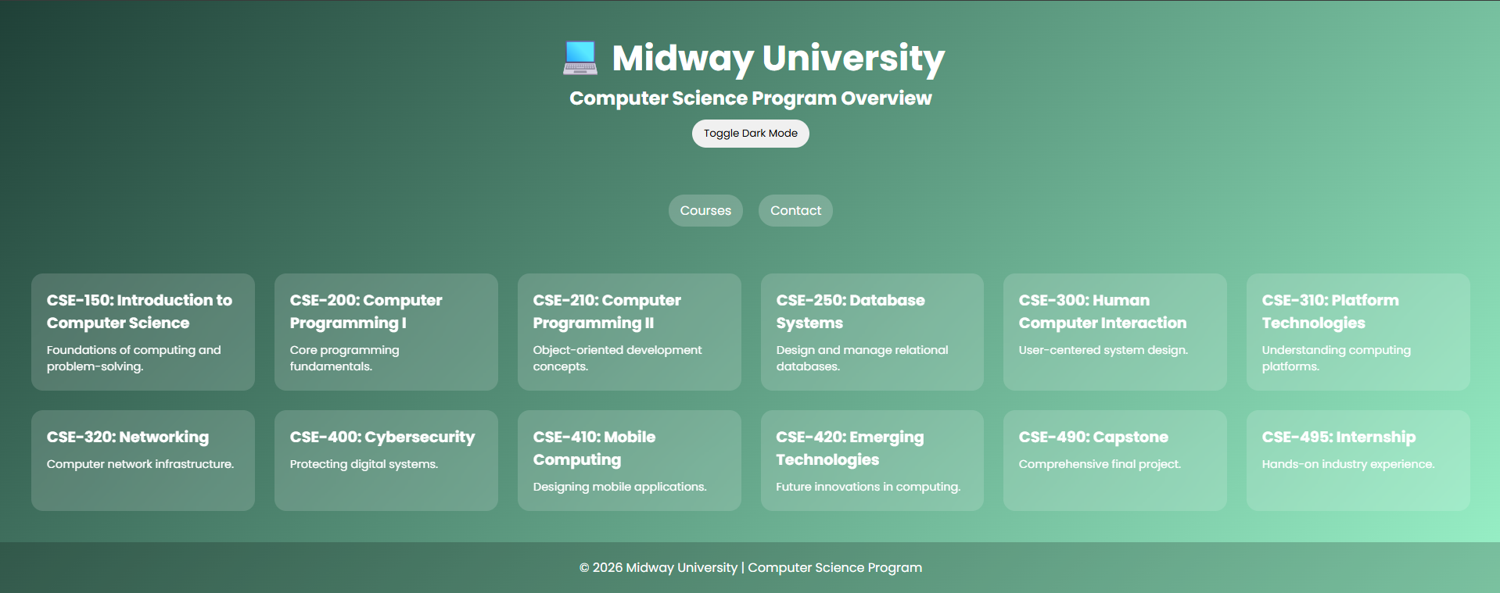
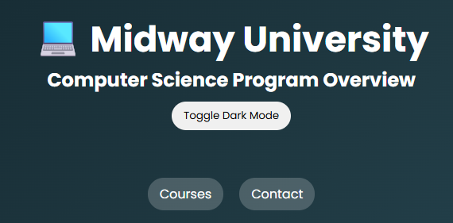
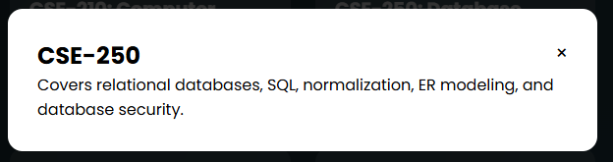
AI
Pleasant to look at
Options I didn’t think of
Made quickly
Bland/Generic
Buttons don’t work
Extremely brief explanations

Slide 6
Final Thoughts
Overall pleased with my webpage
Wish the YouTube links fully worked
Excited to see how everyone else’s turned out!

Slide 7
Thank You

